Slide 1

AI-Powered Fraud Detection in Auto Insurance: Predictive Modeling for Smarter Claims Management
Presented by TEAM(SC2)4_02
Learnathon 2024

Slide 2
The Growing Challenge of Auto Insurance Fraud
Auto insurance fraud is a pervasive issue, costing the industry billions annually. These fraudulent claims lead to increased premiums for honest policyholders and erode trust in the insurance system. Manual detection is often inefficient, time-consuming, and prone to human error, making it difficult to keep pace with sophisticated fraudsters.
Financial Impact
Operational Inefficiency
Customer Impact
Billions lost annually due to fraudulent claims.
Leads to higher premiums and diminished trust.
Manual processes are slow and resource-intensive.

Slide 3



Our Objective: Building a Predictive Fraud Model
Our primary objective is to develop a robust machine learning model capable of accurately predicting fraudulent auto insurance claims. This model will classify claims as either fraudulent ('Y') or legitimate ('N'), providing insurance professionals with a powerful tool for proactive fraud detection.
Intelligent Prediction
Binary Classification
Enhanced Security
Leveraging AI to identify suspicious claims proactively.
Classifying claims as 'Fraud' or 'Legitimate'.
Strengthening fraud detection capabilities for insurers.

Slide 4

Dataset Overview: The Foundation of Our Model
Our analysis is built upon a comprehensive dataset comprising four distinct files: three for training the model and one for testing its performance on unseen data. Each dataset is accompanied by a detailed Data Dictionary, crucial for understanding variable definitions and relationships.
Training Data: 3 separate files for robust model learning.
Test Data: 1 file for evaluating generalisation capabilities.
Data Dictionary: Essential for feature understanding and interpretation.
Initial Data Statistics
Dataset
Rows
Columns (Excl. Target)
Training (Combined)
50,000+
~45 (before feature engineering)
Test
10,000+
~45 (before feature engineering)
Target Variable
Fraud_Ind (Y/N)
Binary Classification

Slide 5
Data Preprocessing: Refining Raw Data
Effective data preprocessing is paramount for building a reliable fraud detection model. We meticulously addressed various data quality issues to ensure the integrity and usability of our dataset.
Missing Values
1
Strategically imputed or removed to preserve data integrity.
Duplicate Entries
2
Eliminated to prevent biased model training.
Date Formatting
3
Standardised for accurate temporal calculations.
Outlier Handling
4
Managed using statistical methods to reduce noise.
Categorical Encoding
5
Transformed using Ordinal and One-Hot Encoding for model compatibility.

Slide 6
Feature Engineering: Unlocking Deeper Insights
Beyond raw data, we engineered new features to enhance the model's ability to detect subtle patterns indicative of fraud. These derived features capture crucial relationships and temporal dynamics within the claim data.
1
2
Claim Delay
Policy Duration
Calculated as Claim_Date - Accident_Date. A significant delay could indicate suspicious activity.
Time elapsed since policy inception, providing context for claim behaviour.
3
4
Mileage & Claim Ratios
Binary Flags
Ratios involving mileage and claim frequency, flagging unusual driving or claiming patterns.
New boolean features indicating the presence of specific conditions (e.g., multiple claims within a short period).

Slide 7
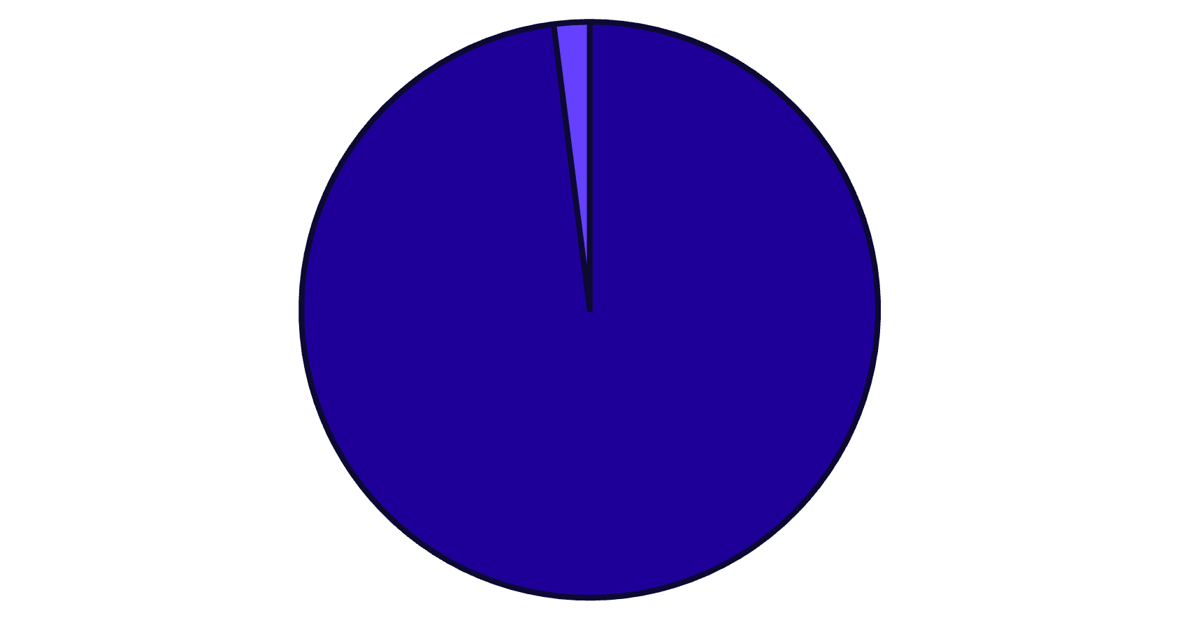
Addressing Class Imbalance: A Critical Step
Fraudulent claims typically represent a small fraction of the total claims, leading to a severe class imbalance. This imbalance can bias models towards the majority class (legitimate claims), resulting in poor fraud detection. We employed several strategies to counter this.
Visualising Imbalance
Techniques Employed
The chart illustrates the stark disparity between legitimate and fraudulent claims in our raw dataset.
SMOTE (Synthetic Minority Over-sampling Technique)
Generated synthetic samples for the minority class (fraudulent claims) to balance the dataset.
Class Weighting
Assigned higher weights to the minority class during model training, forcing the model to pay more attention to fraudulent instances.
Under-sampling (exploratory)
Reduced the number of majority class samples, though SMOTE and class weighting proved more effective.
Legitimate Claims
Fraudulent Claims

Slide 8
Models Trained: A Comprehensive Exploration
We evaluated a diverse range of machine learning models, from traditional statistical approaches to advanced ensemble techniques, to identify the most effective solution for fraud detection. This broad exploration ensured we captured various strengths across different model families.
1
Linear Models
Logistic Regression
Tree-Based Models
2
Decision Tree
Random Forest
Gradient Boosting
3
XGBoost
LightGBM
CatBoost
Other Classifiers
K-Nearest Neighbours (KNN)
4
Support Vector Machine (SVM)
Naive Bayes
MLPClassifier (Neural Network)
5
Ensemble Learning
VotingClassifier

Slide 9
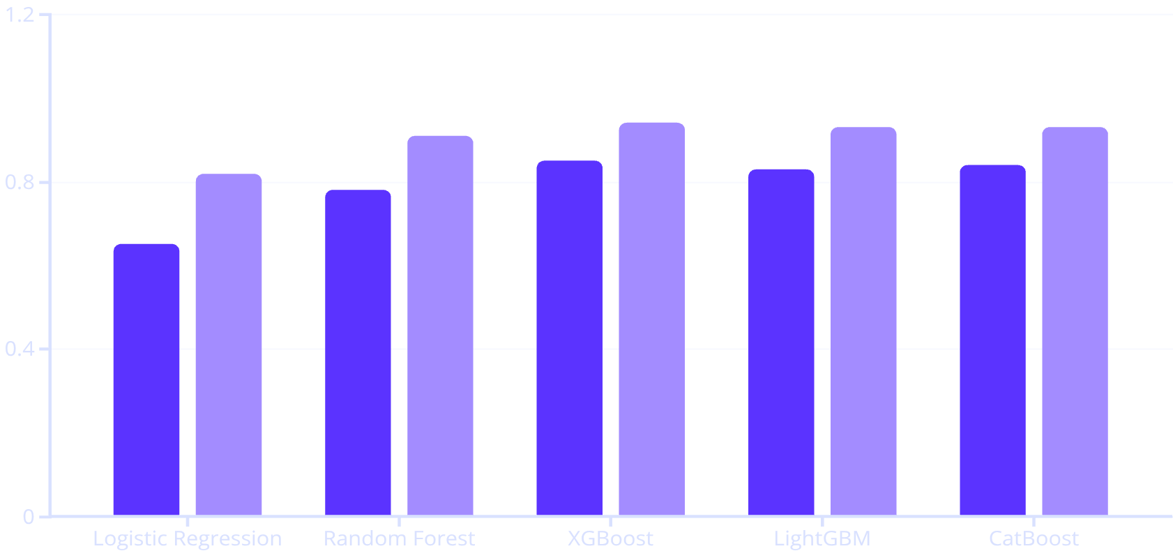
Evaluation Metrics: Measuring Model Performance
To thoroughly assess each model's efficacy, we utilised a suite of standard classification evaluation metrics. These metrics provide a holistic view of performance, particularly crucial in imbalanced datasets like fraud detection.
Key Metrics
Model Performance Comparison (Example)
Accuracy: Overall correctness (Total correct predictions / Total predictions).
Precision: Proportion of positive identifications that were actually correct (True Positives / (True Positives + False Positives)).
Recall (Sensitivity): Proportion of actual positives that were correctly identified (True Positives / (True Positives + False Negatives)).
F1-score: Harmonic mean of Precision and Recall, balancing both.
ROC-AUC: Measures the ability of the model to distinguish between classes. Higher values indicate better performance.
Confusion Matrix: Visualises performance of classification model on test data (True Positives, True Negatives, False Positives, False Negatives).
F1-Score
ROC-AUC

Slide 10


Best Model Selection & Future Scope
Our Champion Model: XGBoost
Future Enhancements
Based on our comprehensive evaluation, the XGBoost model demonstrated superior performance, particularly excelling in ROC-AUC and F1-score. Its robust handling of complex interactions and class imbalance made it the most suitable choice for this fraud detection task. Predictions were generated on the unseen test data and saved to Auto_Insurance_Fraud_Claims_Results_Submission.csv.
Deep Learning Architectures
Explore more complex neural networks for potentially higher accuracy.
Advanced Feature Enrichment
Incorporate external data sources (e.g., social media, public records) for richer context.
Real-time Deployment
Integrate the model into a live claims processing system for instant fraud flagging.
Explainable AI (XAI)
Implement techniques to understand model decisions, fostering trust and transparency.

